Slide 1

Music Theory
By Free Knowledge Mission

Slide 2
Six W’s
Why – Fun, Community, Rewarding
What – Share creativity in writing, singing, playing music
Who – Local community, Share online
When – Every Saturday at 10 AM
Where – TVF&R Station 67
How – One hour a week
10 minute Intros
20 minute talk, 10 minute Q&A
20 minutes brainstorming new topics

Slide 3
Teaching Style
Intermediate
Beginner (Analogies)
Advanced
Switch between levels

Slide 4
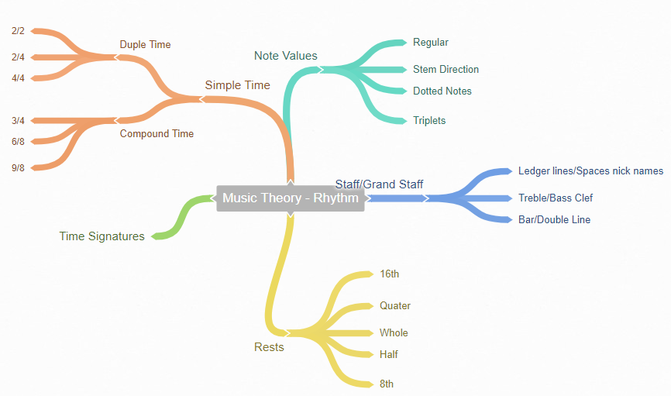
Example Mind Map Strategy – Theory, Singing, Instrument

Slide 5
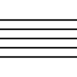
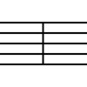
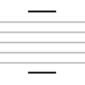
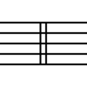
Lesson 1 - Basics
(a) Staff- the lines on which musical notation is written
(b) Bar Line- a line that separates the staff into measures
(c) Ledger Lines- lines that extend the staff up and down
(d) Double Bar Line- two lines that either can separate two sections of music, or end the piece
A
B
C
D

Slide 6
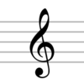
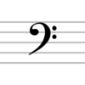
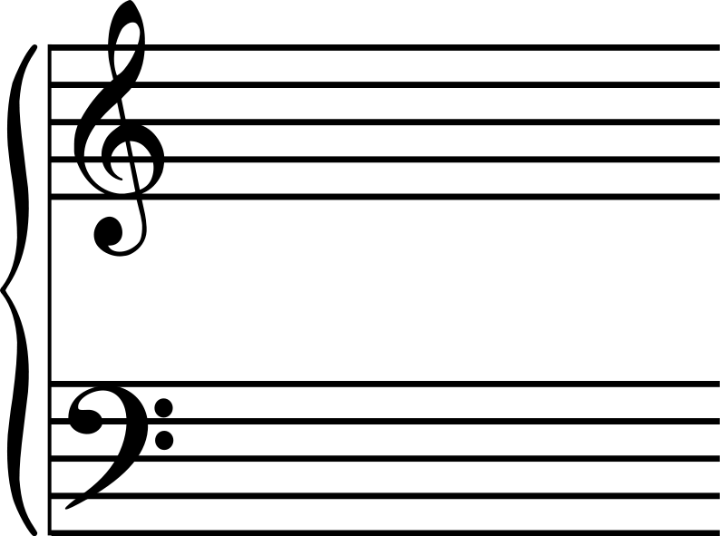
The Clef Symbols & Staff
The Treble Clef is also known as the “G Clef” because the curl in the symbol wraps around the line on the staff that is named G.
The Bass Clef is known as the “F Clef” because the two dots are centered on the line F.
Grand Staff

Slide 7
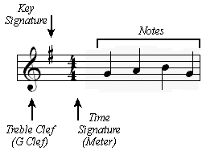
Key & Time Signatures
The Clef symbol will help indicate the voicing. Often times, the Treble Clef will be used for higher voices, and the Bass Clef for lower voices, but there are exceptions.
The Key Signature helps to identify which notes on the staff are raised and lowered, and the effect remains throughout unless an accidental cancels the effect.
The Time Signature sets what the rhythm of the music is. The top number identifies how many beats are in a measure, and the bottom number identifies what note value the beat is.

Slide 8
Note Names
The musical alphabet uses the letters A-G. The lines and spaces of the Treble Clef and the Bass Clef are spelled differently.
Treble Clef from the bottom up
Every Good Boy Deserves Fudge
The spaces spell the word FACE
Bass Clef from the bottom up
Green Birds Don’t Fly Away
All Cows Eat Grass

Slide 9






Note Values & Stem Direction
Whole, half, quarter, eight, sixteenth, thirty second

Slide 10
Lesson 4
Time Signature

Slide 11

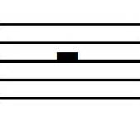
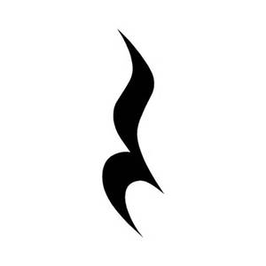

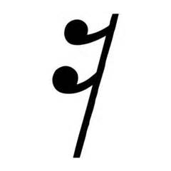
Rests
Whole
Half
Quarter
Eighth
Sixteenth

Slide 12
Practice
Draw 20 grand staffs
Practice staff and notes I’ve written
Create 20 bars in 2/4, ¾, 4/4, 6/8

Slide 13
Upcoming Schedule & Brainstorm New Topics
Share upcoming schedule
Music Theory, Singing, Instrument
I’ll share a couple topics
Each person can volunteer to share an idea
We’ll vote at the end
Winner gets creator of the week

Slide 14
Resources
Lypur – Andrew Furmanczyk
Notes and Slides

